Slide 1

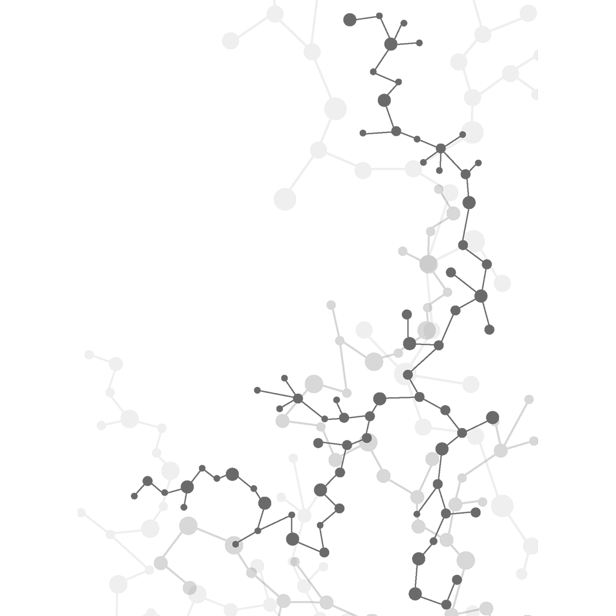

Virtual Workshop 2 October, 2020
Presented by AI@Penn

Slide 2
Introduction
Purpose: equip students with ability to harness AI technology, and apply it to real-world scenarios – business, financial, healthcare, etc.
Workshop approach: learn how an algorithm works, understand the basics of a data pre-processing tool and apply the knowledge to a real life dataset.

Slide 3
Quick Note
Fill this out: https://forms.gle/PsBLF5cApFisAv4g8
Stay notified about workshops, speakers, etc.

Slide 4
Overview of Coming Weeks
Session 3: Linear Regression (Real Estate Valuation)
Session 4 - Neural Networks (News Outreach)
Session 5 - LSTM Networks (Stock Price Prediction)
Intersperse with guest presentations, practical project sessions (e.g. OpenCV, iPhone applications, recommender systems).

Slide 5
Today’s Plan
Learn about the fundamental classification model Logistic Regression
Learn about the intuitive Decision Tree classification model, Bagging (Bootstrap Aggregating), and Random Forest Ensemble
Program them in Google Collab Notebook to Predict Credit Card Defaults

Slide 6
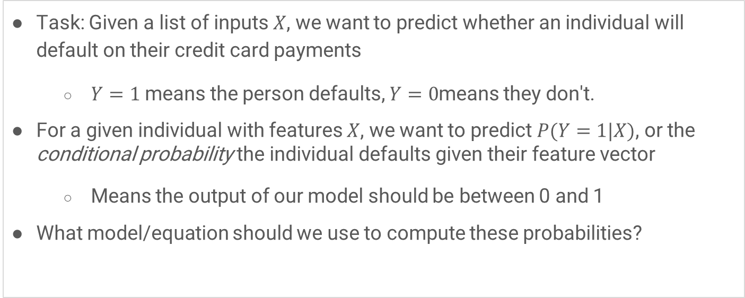
Logistic Regression Intuition
Task: Given a list of inputs $X$, we want to predict whether an individual will default on their credit card payments
$Y=1$ means the person defaults, $Y=0$means they don't.
For a given individual with features $X$, we want to predict $P(Y=1|X)$, or the conditional probability the individual defaults given their feature vector
Means the output of our model should be between 0 and 1
What model/equation should we use to compute these probabilities?

Slide 7
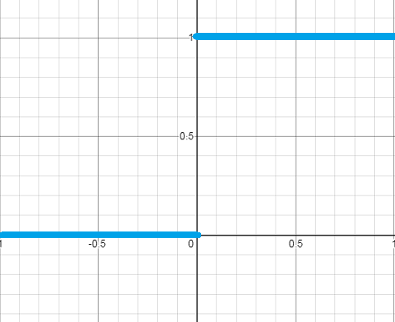
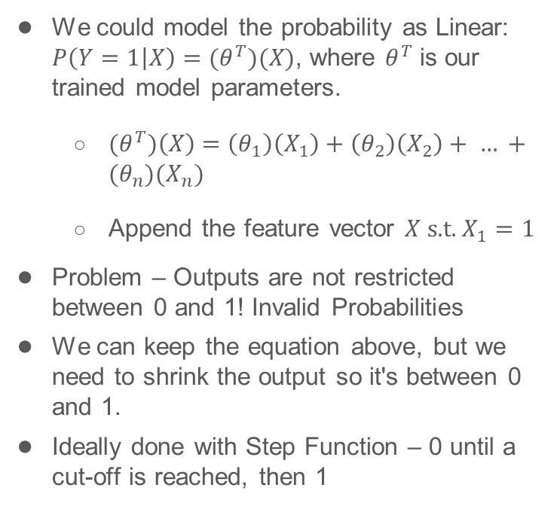
Computing P(Y=1|X) with LR
We could model the probability as Linear: $P\left(Y=1 | X\right)=(θ^{T})(X)$, where $θ^{T}$ is our trained model parameters.
${(θ}^{T})\left(X\right)=\left(θ_{1}\right)\left(X_{1}\right)+\left(θ_{2}\right)\left(X_{2}\right)+ … +(θ_{n})(X_{n})$
Append the feature vector $X \text{s}\text{.}\text{t}\text{. }X_{1}=1$
Problem – Outputs are not restricted between 0 and 1! Invalid Probabilities
We can keep the equation above, but we need to shrink the output so it's between 0 and 1.
Ideally done with Step Function – 0 until a cut-off is reached, then 1

Slide 8

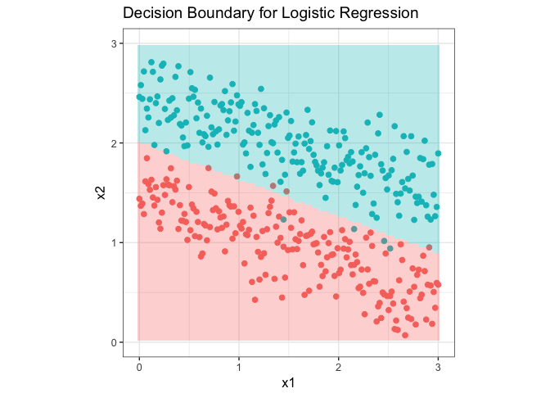
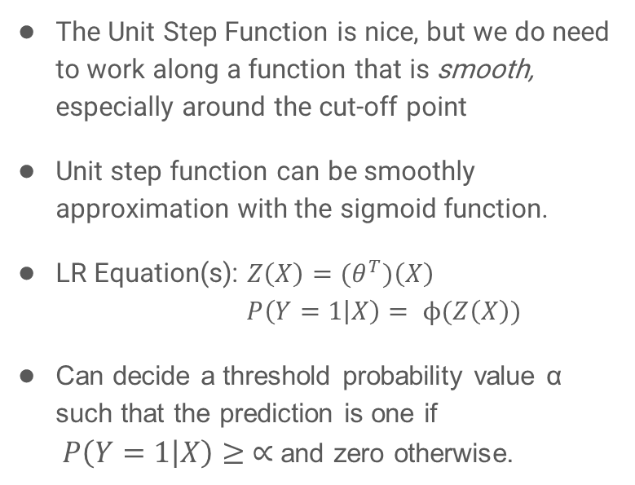
The LR Regression Equation
The Unit Step Function is nice, but we do need to work along a function that is smooth, especially around the cut-off point
Unit step function can be smoothly approximation with the sigmoid function.
LR Equation(s): $Z\left(X\right)=(θ^{T})\left(X\right)$ $P\left(Y=1 | X\right)= ϕ(Z\left(X\right))$
Can decide a threshold probability value α such that the prediction is one if $P\left(Y=1 | X\right)≥ ∝$ and zero otherwise.

Slide 9
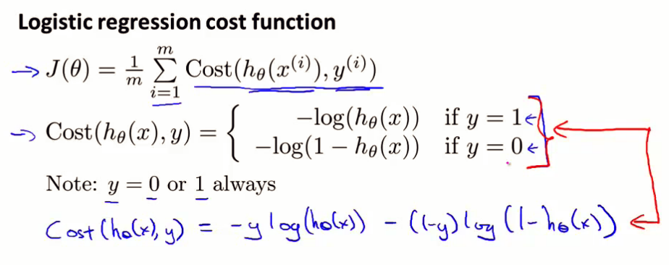
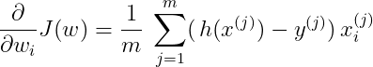
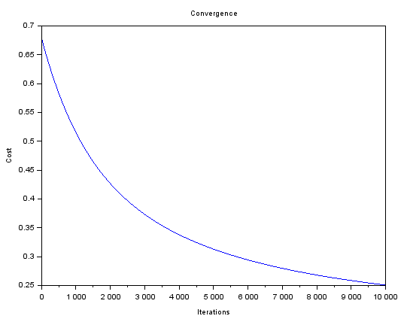
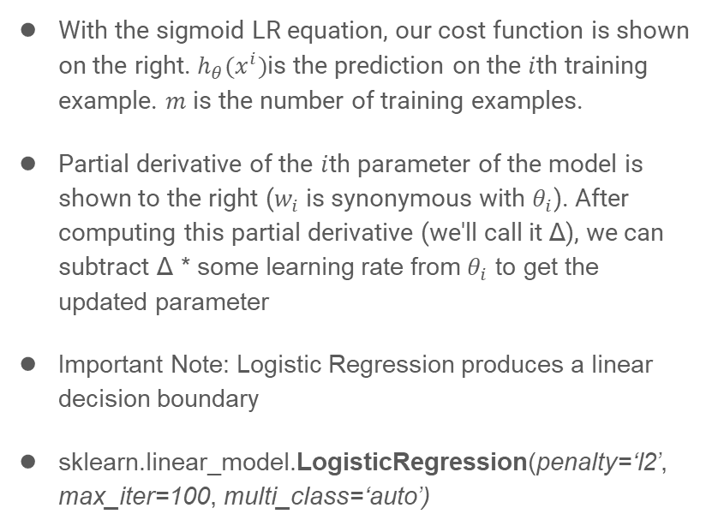
LR Equation Additional Notes
With the sigmoid LR equation, our cost function is shown on the right. $h_{θ}(x^{i})$is the prediction on the $i$th training example. $m$ is the number of training examples.
Partial derivative of the $i$th parameter of the model is shown to the right ($w_{i}$ is synonymous with $θ_{i}$). After computing this partial derivative (we'll call it Δ), we can subtract Δ * some learning rate from $θ_{i}$ to get the updated parameter
Important Note: Logistic Regression produces a linear decision boundary
sklearn.linear_model.LogisticRegression(penalty=‘l2’, max_iter=100, multi_class=‘auto’)

Slide 10
Decision Trees (I)
Structed as a binary series of connected nodes and leaves
Each node contains a logic gate related to the data’s predictors, splitting the data into two sections
Each leaf represents a class — you can have multiple leaves with the same class, but you need at least one leaf for each class
Like sorting items into bins (plastic -> recycle, food -> trash can, etc.)

Slide 11
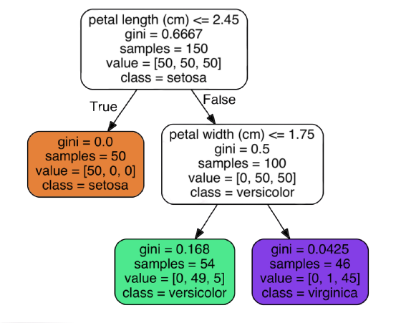
Decision Tree Visualization

Slide 12
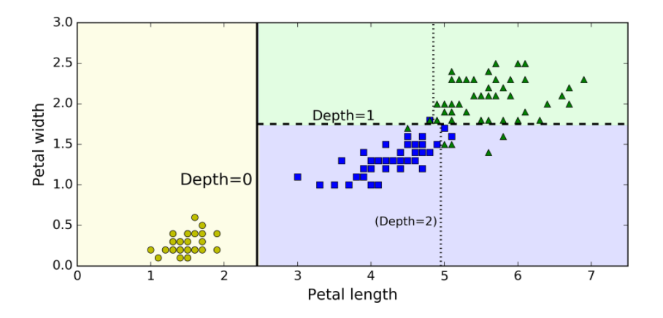
Decision Tree Visualization

Slide 13
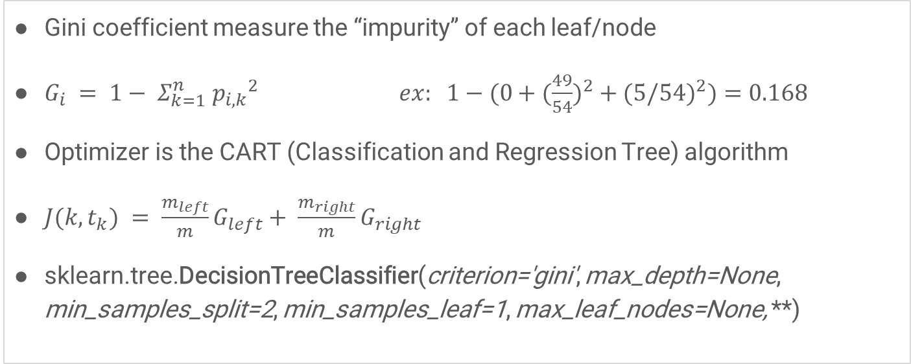
Decision Trees (II)
Gini coefficient measure the “impurity” of each leaf/node
${G_{i} = 1− Σ}_{k=1}^{n} {p_{i, k}}^{2} ex: {1−(0+(\frac{49}{54})}^{2}+({5/54)}^{2})=0.168$
Optimizer is the CART (Classification and Regression Tree) algorithm
$J(k,t_{k}) = \frac{m_{left}}{m}G_{left}+ \frac{m_{right}}{m}G_{right}$
sklearn.tree.DecisionTreeClassifier(criterion='gini', max_depth=None, min_samples_split=2, min_samples_leaf=1, max_leaf_nodes=None, **)

Slide 14
Bagging (and Pasting)
Training many iterations of the same type of machine learning model on different subsets of the data
Data is sampled with replacement (without replacement is called Pasting)
Voting Methods:
Hard voting (uses only the predicted class)
Soft voting (uses probability values of each class)
sklearn.ensemble.BaggingClassifier(base_estimator=None, n_estimators=10, bootstrap=True, **)

Slide 15
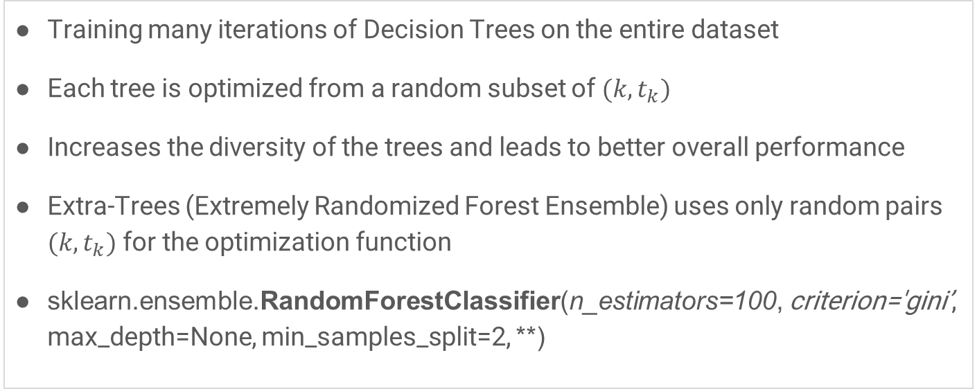
Random Forest
Training many iterations of Decision Trees on the entire dataset
Each tree is optimized from a random subset of $(k,t_{k})$
Increases the diversity of the trees and leads to better overall performance
Extra-Trees (Extremely Randomized Forest Ensemble) uses only random pairs $(k,t_{k})$for the optimization function
sklearn.ensemble.RandomForestClassifier(n_estimators=100, criterion='gini’, max_depth=None, min_samples_split=2, **)

Slide 16
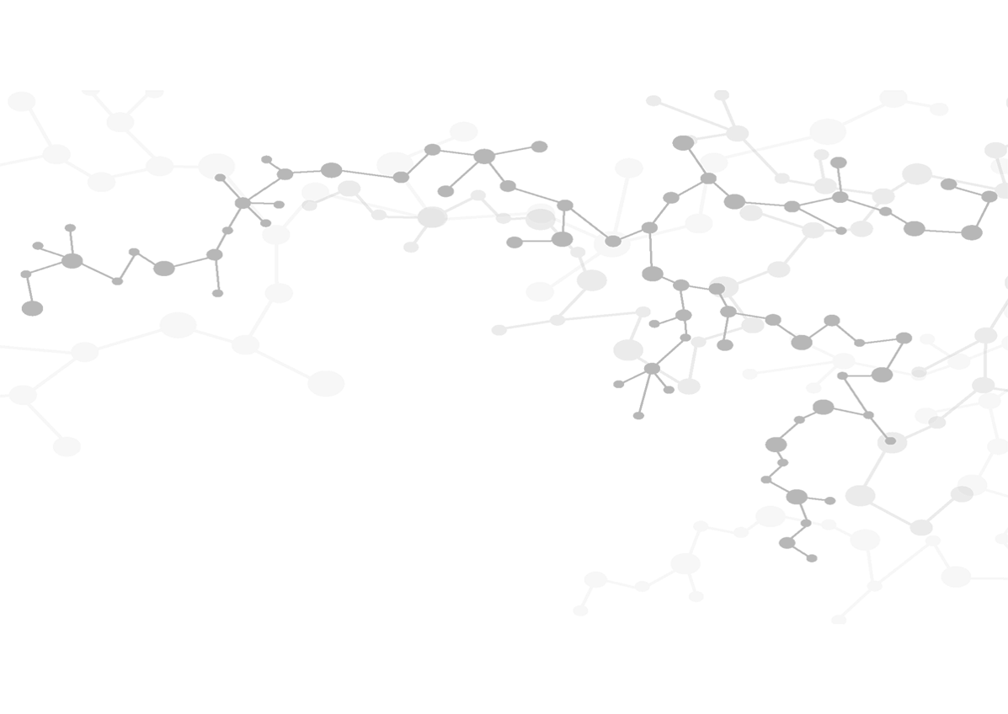
Next steps: https://github.com/kjaisingh/AI-Penn

